Slide 1
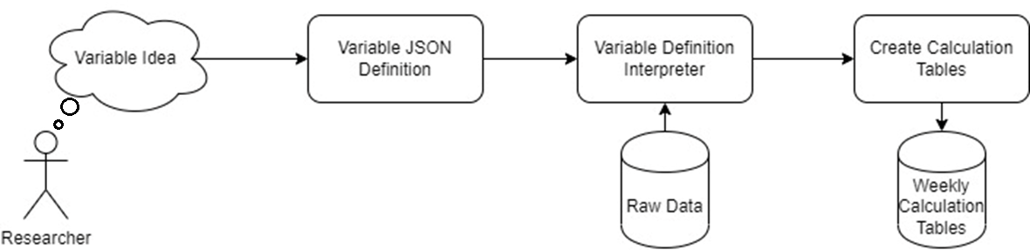
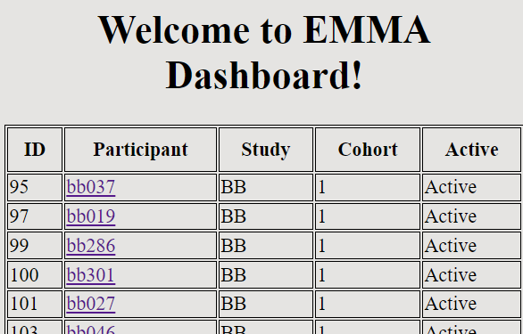
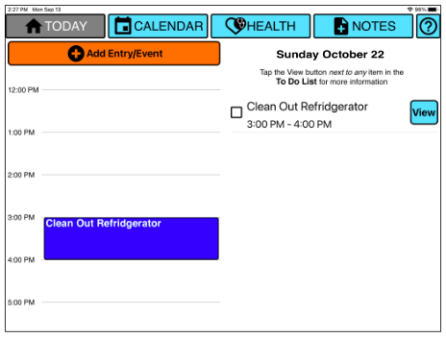
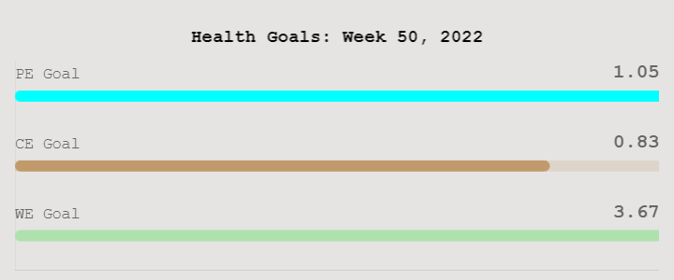
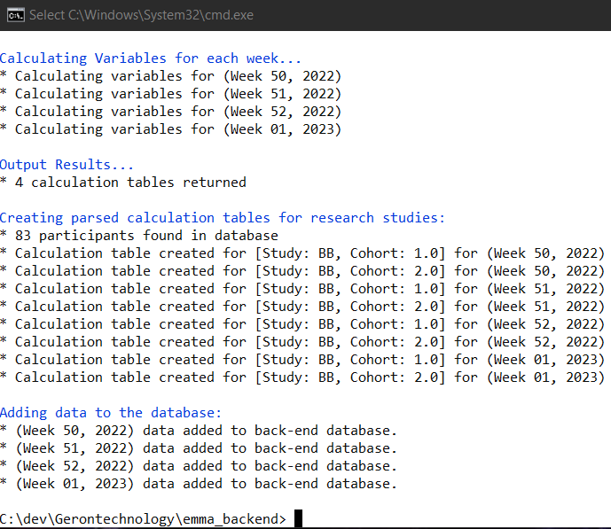
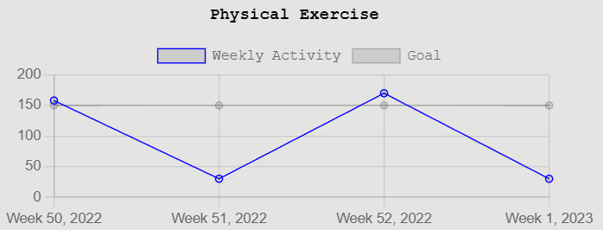
Development of Backend Calculation Algorithms and User Interface for an iOS Application for Cognitively Impaired Older Adults
Reagan Kelley ², Catherine Luna¹, Diane Cook² , & Maureen Schmitter-Edgecombe¹
¹College of Arts and Sciences, Psychology; ² Voiland College of Engineering, Computer Science
Scope
The Electronic Memory and Management Aid (EMMA) is an iOS tablet application developed by the WSU Neuropsychology and Aging Laboratory to serve as a memory intervention for older adults experiencing cognitive decline.
The EMMA app is currently being used by neuropsychologists in multiple research studies to explore its experimental and clinical utility.
Project Need: Researchers and clinicians need to examine how participants use EMMA and the effectiveness of experimental manipulations
Project Aim 1: Develop an algorithm system to calculate summary variables of EMMA app use
Project Aim 2: Design a web-based user interface for clinicians to view a snapshot of EMMA app use
Aim 1: Data Wrangling
aim 2: Dashboard
Figure 2. EMMA variable calculation process
Figure 4. Snapshot of the EMMA dashboard home page
Why json?
JSON is good for reducing complexity into attribute notation
It is easy to read
Provides a quick and simple solution to implement new variable ideas.
It can be processed by code quickly
User interface for clinicians
The dashboard brings the results from data wrangling back to the end user.
Retrieves back-end calculation tables and presents the variable data in a meaningful way.
Figure 1. EMMA app home screen
From json to code
We designed a variable definition interpreter that can understand the context of each variable definition.
Read JSON attributes as parameters for variables, these parameters determines what app-use data to use and how to aggregate it.
Figure 5. Health goal variables presented as three progress bars.
Figure 3. Sample Data wrangling output
Figure 6. A participant’s weekly physical exercise over the course of a month.
Designing Solution
Researchers have many ideas for variables that can be collected and measured from EMMA data.
Problem: How to easily define new variables that can then be added to the data wrangling system, and how to store these calculations efficiently.
Data wrangling prep….
Project Aim 1 Solution: Data Wrangling
Project Aim 2 Solution: Dashboard
Receive feedback from researchers and clinicians to create new variables and better metrics.
Future Directions
Attach data wrangling and Dashboard to the EMMA mainframe
Create new variables for new studies
With over 100 variable definitions currently defined, our latest version can calculate weekly calculation tables for hundreds of participants throughout multiple studies within seconds.
Support and Contact
WSU/NIH Gerontechnology-Focused Student Undergraduate Research Experience (GSUR)
catherine.luna@wsu.edu; Lab Twitter: @WSUNeuroTechLab

